Slide 1
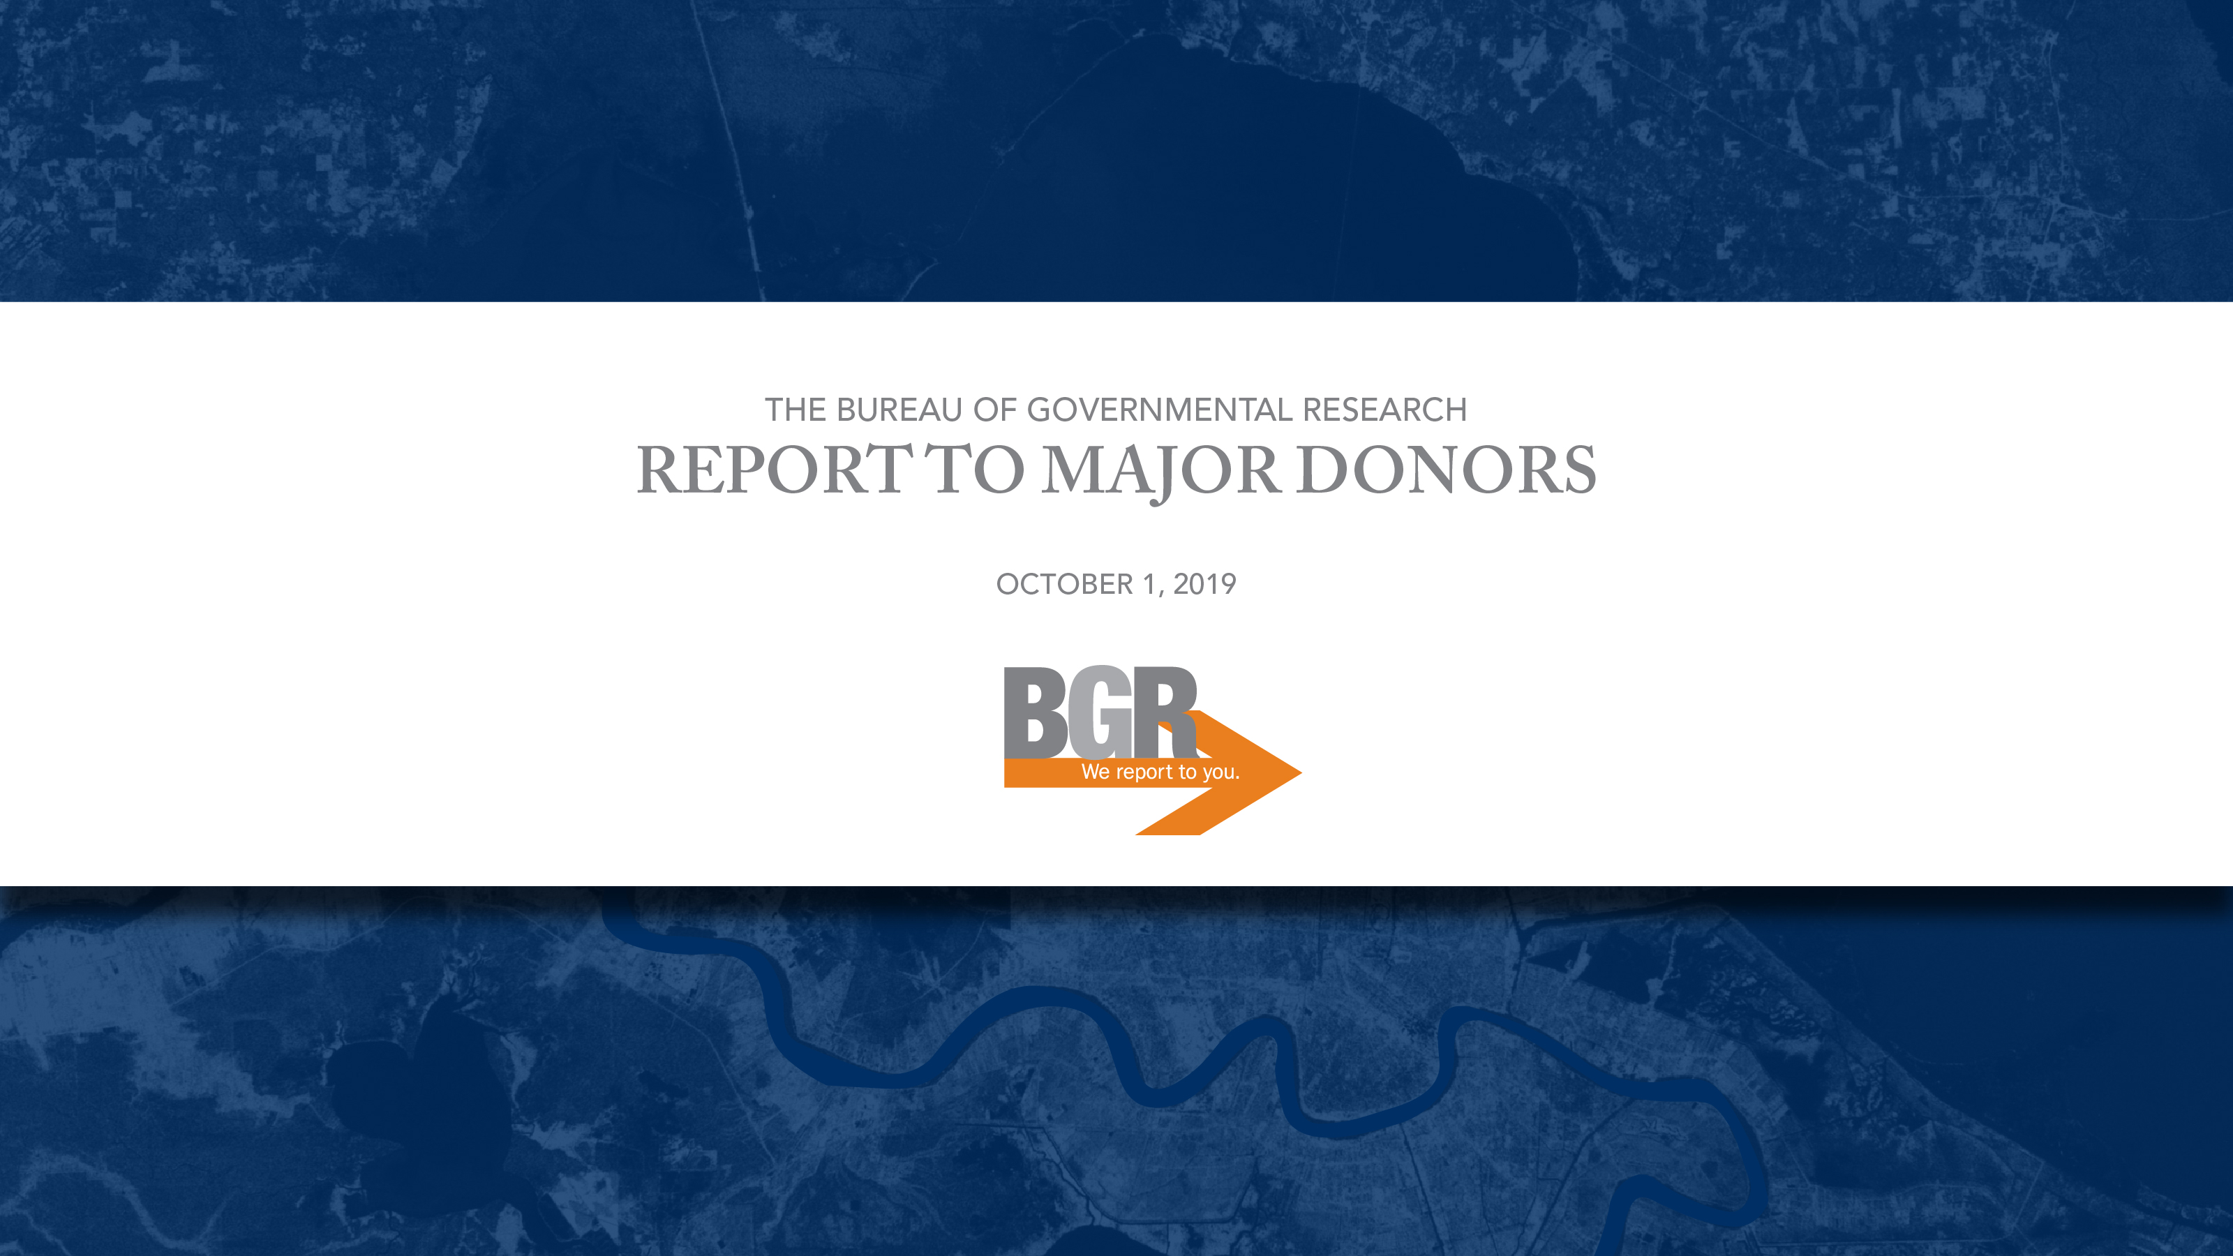
PRESENTATION TO NEW ORLEANS REGIONAL COUNCIL FOR BUSINESS ECONOMICS
FEBRUARY 20, 2024

Slide 2
TODAY’S AGENDA
Introduction to BGR
Research and Results
Property Tax Dashboards

Slide 3
INTRODUCTION TO BGR
Who we are.
Independent research organization
Objective voice on local public policy
Experienced research team
What we do.
Work daily to identify public policy problems and solve them
Constructive, deliberate process
Provide transparency, objectivity and a foundation for engagement
Why we do it.
Improve government in its efficiency, effectiveness, accountability and transparency
Create potential for transformative change in local government

Slide 4

Our Mission
The Bureau of Governmental Research is a private, nonprofit, independent research organization dedicated to informed public policy making and the effective use of public resources for the improvement of government in the New Orleans metropolitan area.

Slide 5
BGR’s Value Proposition
We help voters be virtuous by helping them to make informed choices.
We help civic leaders to champion important causes by helping them to lead with well-researched ideas and get up to speed on topics of interest at our Breakfast Briefings.
We help frustrated citizens to become more hopeful by providing accountability and looking out for their interests.
We support a shrinking news media by comprehensively and systematically monitoring what’s happening in government, serving as a resource to reporters, and examining core issues they can’t get to.
We help public officials implement smart policy with the public’s long-range interests in mind.

Slide 6
Safeguarding Our Independence
Financial: BGR does not receive public funding or contracts for its work.
Research: BGR stays nonpartisan, objective and does not endorse candidates.
Implementation: BGR disassociates, when necessary, from any policy implementation effort that departs from BGR recommendations and risks different or diminished policy outcomes.
Participation: BGR declines invitations to participate on task forces and other policy/advocacy initiatives when it could create a real or perceived conflict of interest with our independent research.
BGR protects our independence so we are always free to weigh in on matters of public affairs. Citizens can trust that BGR has only their interests in mind.

Slide 7
RESEARCH AND RESULTS
1930s & 40s – BGR works on City of New Orleans and State government reforms; PAR spun off in 1950 to focus on State issues
1950s – BGR helps to draft the City’s home rule charter
1960s – Seven-volume study lays a foundation for preserving French Quarter
1970s – BGR studies improvements for Audubon Zoo
1980s – Research supports new capital planning process
1990s – BGR identifies new paths on tax exemptions and contracting
2000s – Post-Katrina research supports planning and assessor reforms
2010s – Contracting reform and alignment of school funding with charter system
2020s – Push for fiscal accountability during and after pandemic

Slide 8
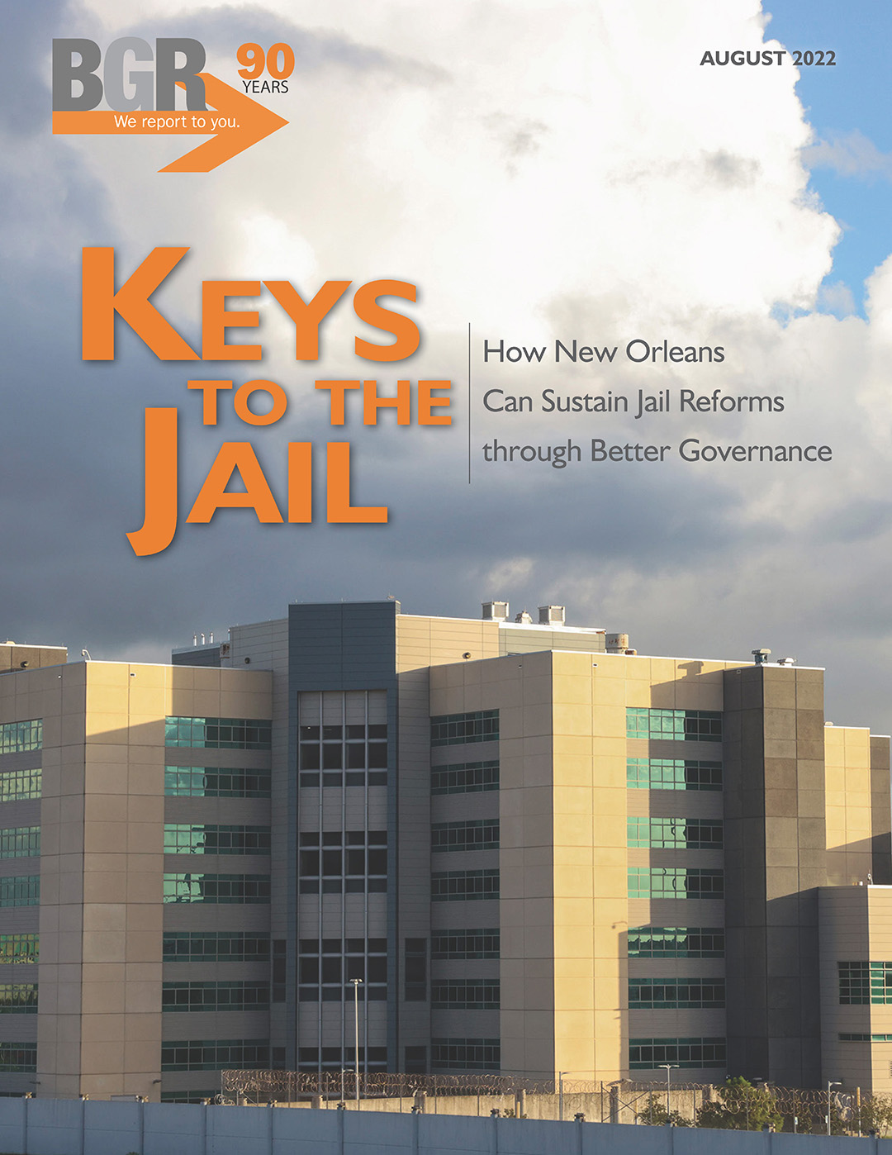

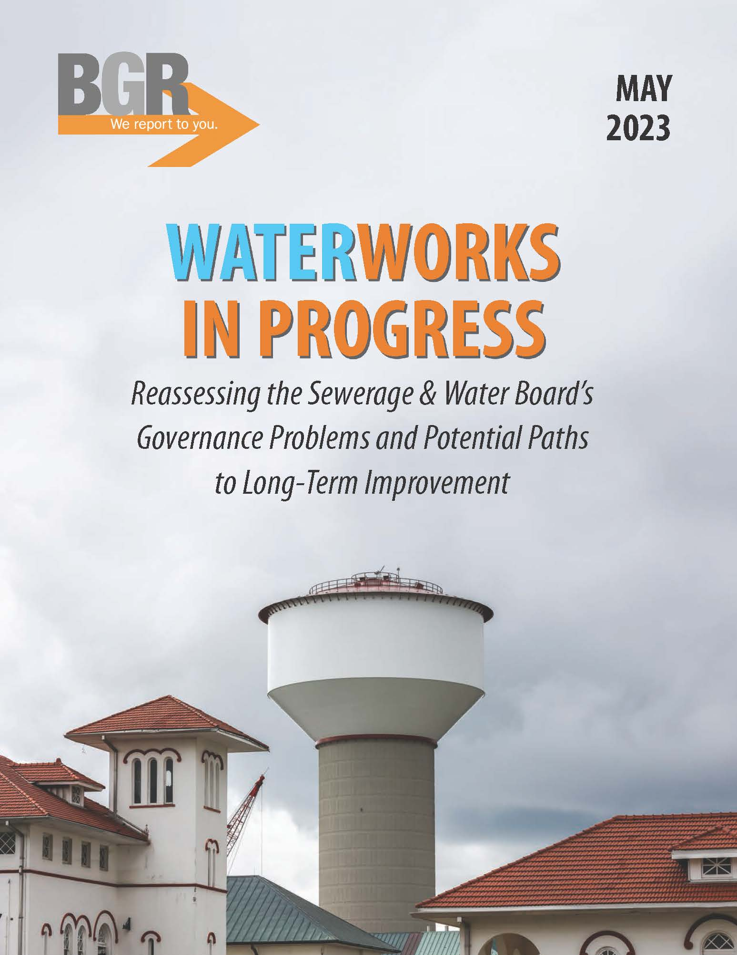

Major Reports Published in 2022 & 2023

Slide 9
Highlights of BGR’s Impact in the Past Decade
Improved accountability for New Orleans’ K-12 public school funding
1% hotel tax ($12.3 million a year pre-pandemic) restored and dedicated to New Orleans infrastructure
Reconsideration of Convention Center hotel project
Improved school tax in Jefferson Parish
Defeat of 2014 legislation to reduce independence of regional flood protection authorities
Reallocation of $39 million in accumulated tax revenues to New Orleans schools

Slide 10

Persistence toward Better Local Government
In 2019, our report, Assessing the Assessor, made recommendations to the Orleans Parish Assessor to improve the accuracy of property assessments.
Recently, New Orleans City Council members cited BGR’s report in calling for a state-level review of the new assessment rolls.
In late December, the LLA affirmed BGR’s findings, prompting the New Orleans City Council to ask the assessor to re-assess portions of the tax rolls.

Slide 11
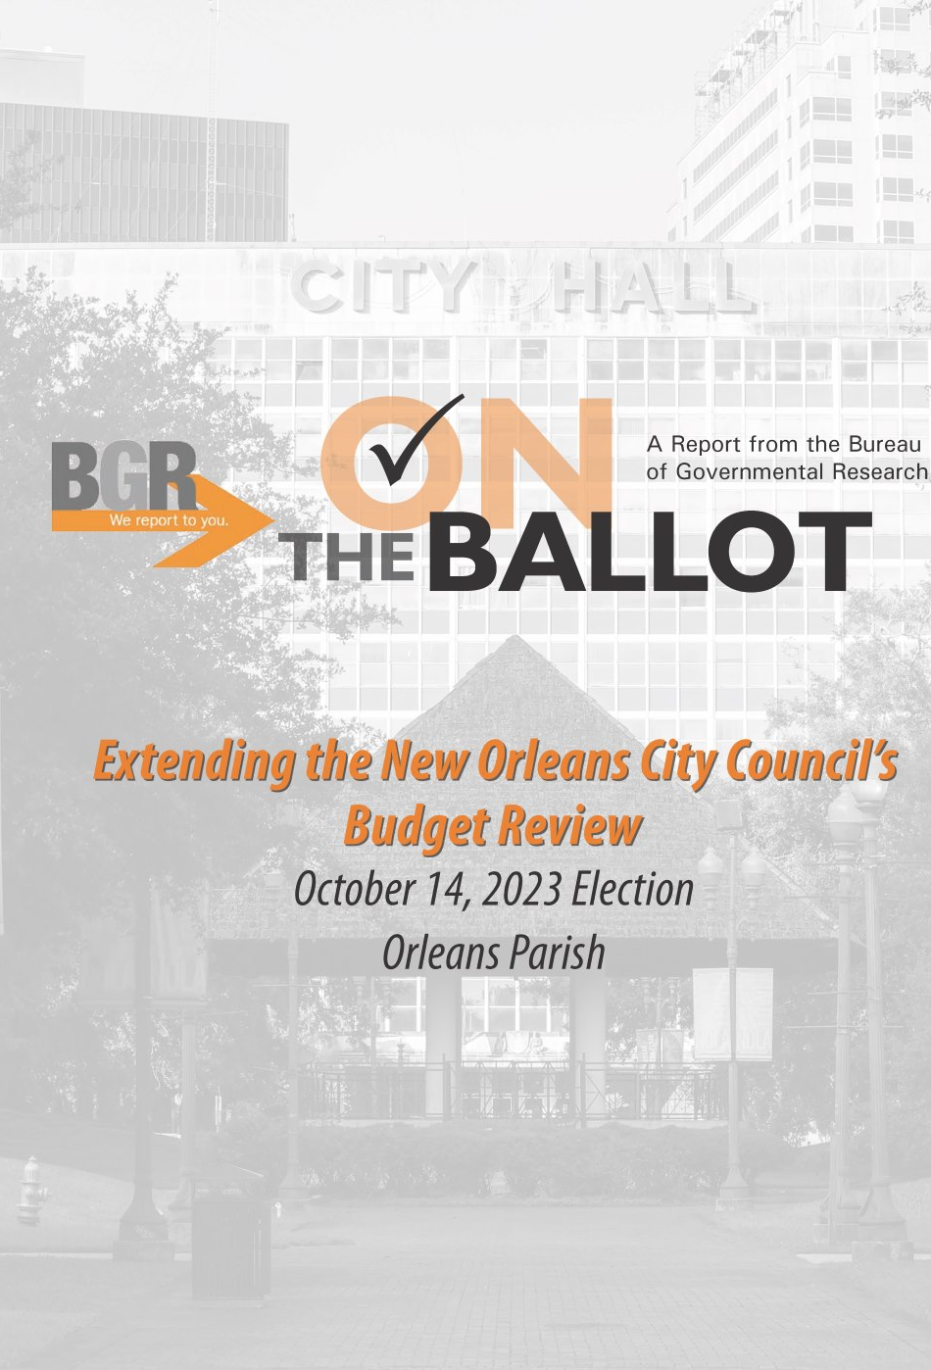
BGR Ballot Reports in 2022 & 2023
New Orleans Early Childhood Education Property Tax
Jefferson Parish Sheriff’s Office Property Tax
District Attorney’s Sales Tax Proposal in St. Tammany
Orleans Parish Sheriff’s Office Property Tax
New Orleans School Facilities Property Tax Renewal
New Orleans Charter Amendment: Reorganizing Code Enforcement
New Orleans Charter Amendment: City Council Budget Review

Slide 12
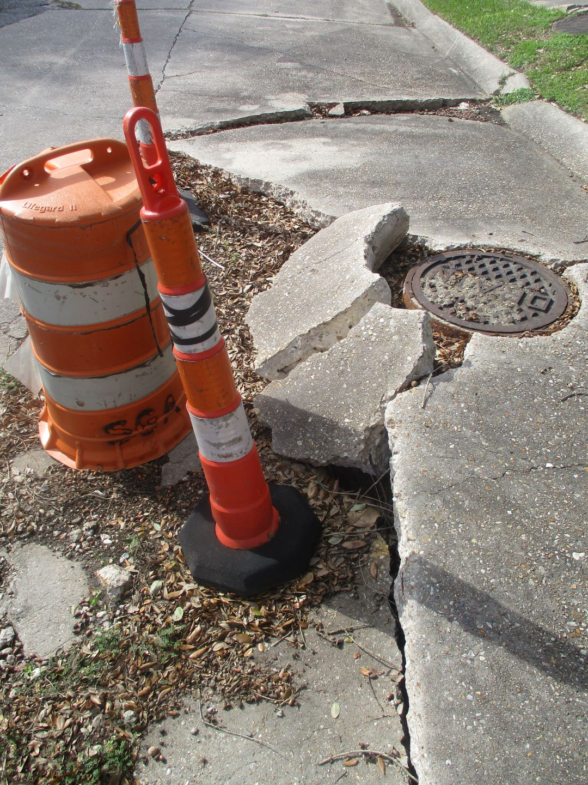
Current Research Projects
Online Dashboard of Local Taxes
Update on Tax-Exempt Property
Update on Fair Share Infrastructure Funding
Public investment in River District

Slide 13
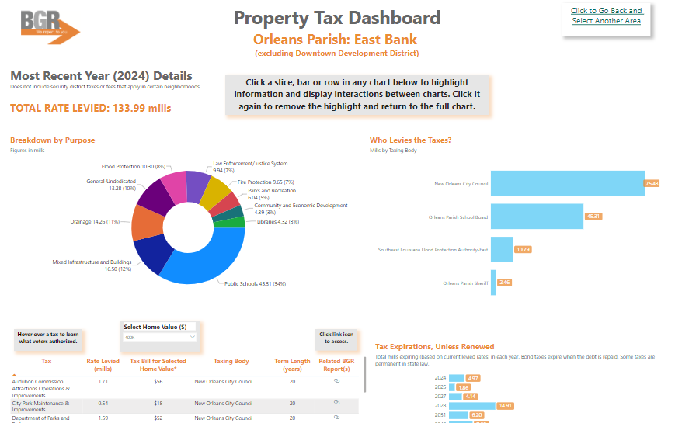
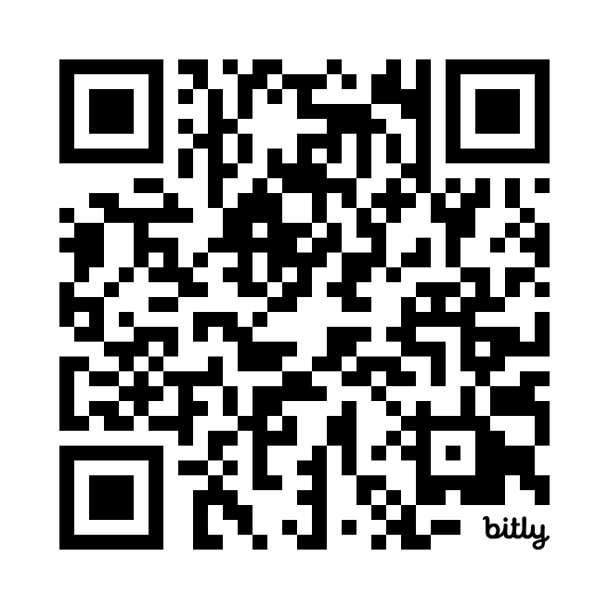
PROPERTY TAX DASHBOARDS
Explore property taxes in Jefferson,
Orleans and St. Tammany Parishes at
https://www.bgr.org/property-tax-dashboards

Slide 14




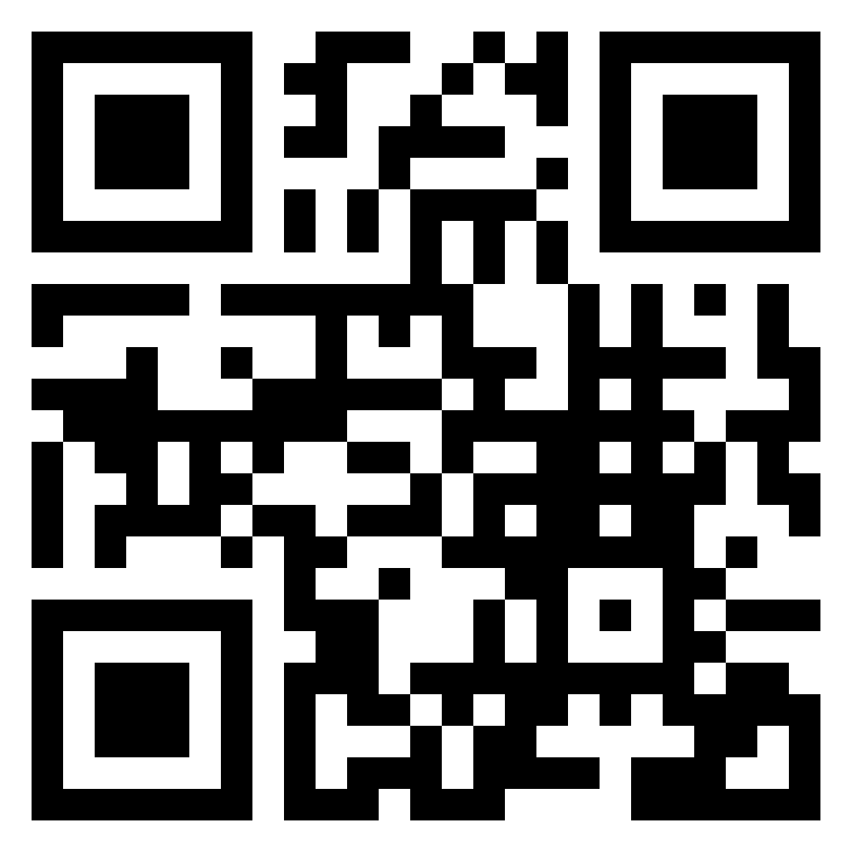
Thank you, and Stay in Touch!
BGRNola BGRNola bgrnola Bureau of Governmental Research
NEWSLETTERS
New reports, upcoming events and other BGR news
bgr.org/newsletter
Weekday newsletter of public policy news affecting the New Orleans area
bgr.org/daily-policy-news
MEMBERSHIP
It is easy to join BGR! Encourage your family, friends and colleagues
bgr.org/membership

