Slide 1

My Vision for UNO and New Orleans
New Orleans Regional Council for Business Economics
January 9, 2024

Slide 2

Some National Context from the Georgetown Center for Education and the Workforce:
Continued need for workers to have greater education (68% of jobs required some postsecondary ed in 2021; ~72% by 2031)
Automation/AI/Technology will eliminate specific tasks within jobs (not entire jobs)
Occupations in the managerial/professional sectors of the economy will have the greatest proportion of postsecondary-educated workers in 2031
Almost all opportunities for workers w/ HS degree will be in blue collar/skilled trades
https://cew.georgetown.edu/cew-reports/projections2031/#resources

Slide 3
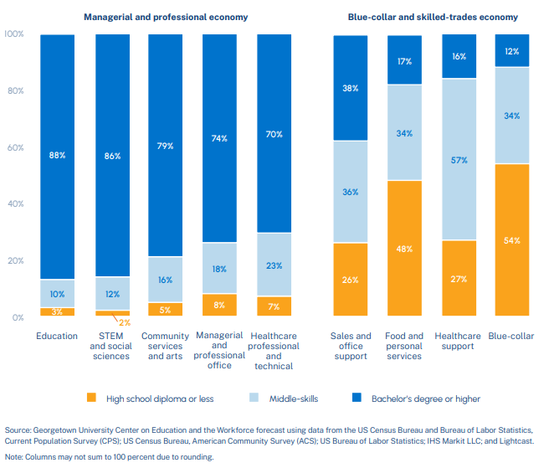

Slide 4
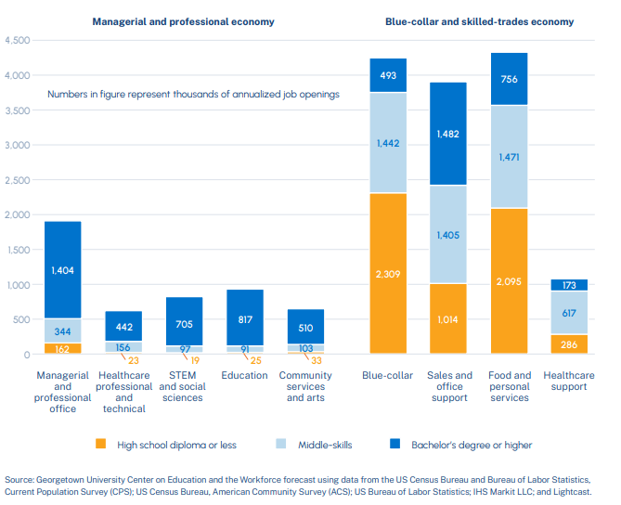

Slide 5
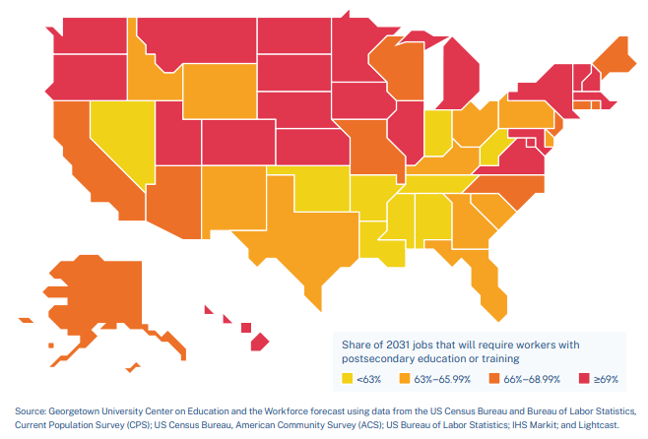
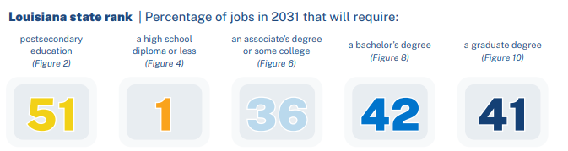
What About Louisiana?
https://cew.georgetown.edu/wp-content/uploads/Projections_2031-State-Report.pdf

Slide 6
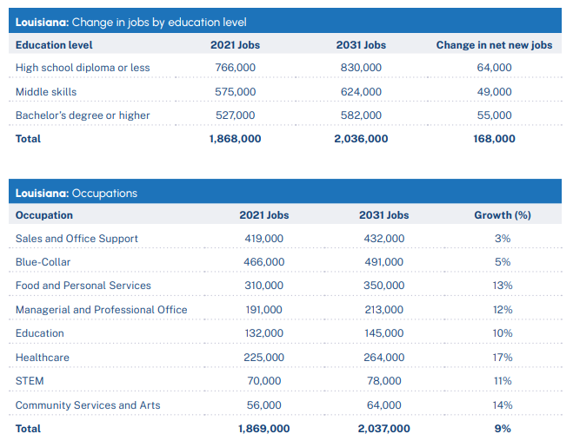
UNO (and all Universities) must BOTH
contribute to job CREATION through economic development
Expand access to post-secondary credentials for a wide array of learners
https://cew.georgetown.edu/wp-content/uploads/Projections_2031-State-Report.pdf

Slide 7


University of New Orleans Planning Priorities
Student Learning and Success
Increasing student retention and success
Investing in technologies and facilities to support student learning
Expanding transfer pathways
Offering credentials of value to adult learners
Strategic recruitment beyond LA in programs for which there is capacity for growth

Slide 8

University of New Orleans Planning Priorities
Research and Creative Activity
Expanding student engagement in research
Investing in programs aligned with economic priorities (computer science, engineering, energy, hotel, restaurant & tourism, urban planning)
Capitalizing on synergies through The Beach (UNO Research & Technology Park)

Slide 9
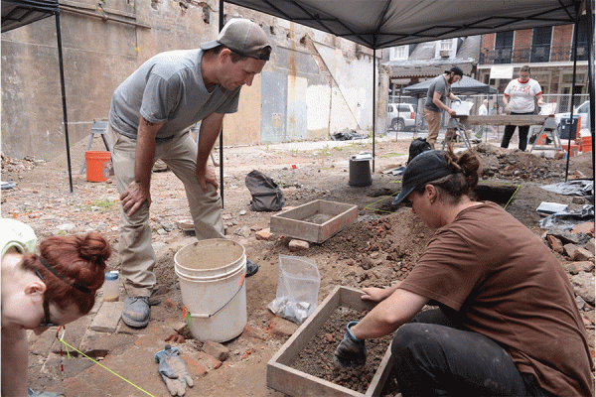
University of New Orleans Planning Priorities
Community Engagement
Expanding service learning and internships across New Orleans
UNO as anchor institution
Incentivizing translational/applied research and public scholarship
New Orleans as an extension of the classroom for all students
UNO faculty/staff/students engaged in helping to address issues of significance for New Orleans
Collective Impact – GNO, Inc. Higher Education Consortium
Alumni appreciation/engagement

Slide 10
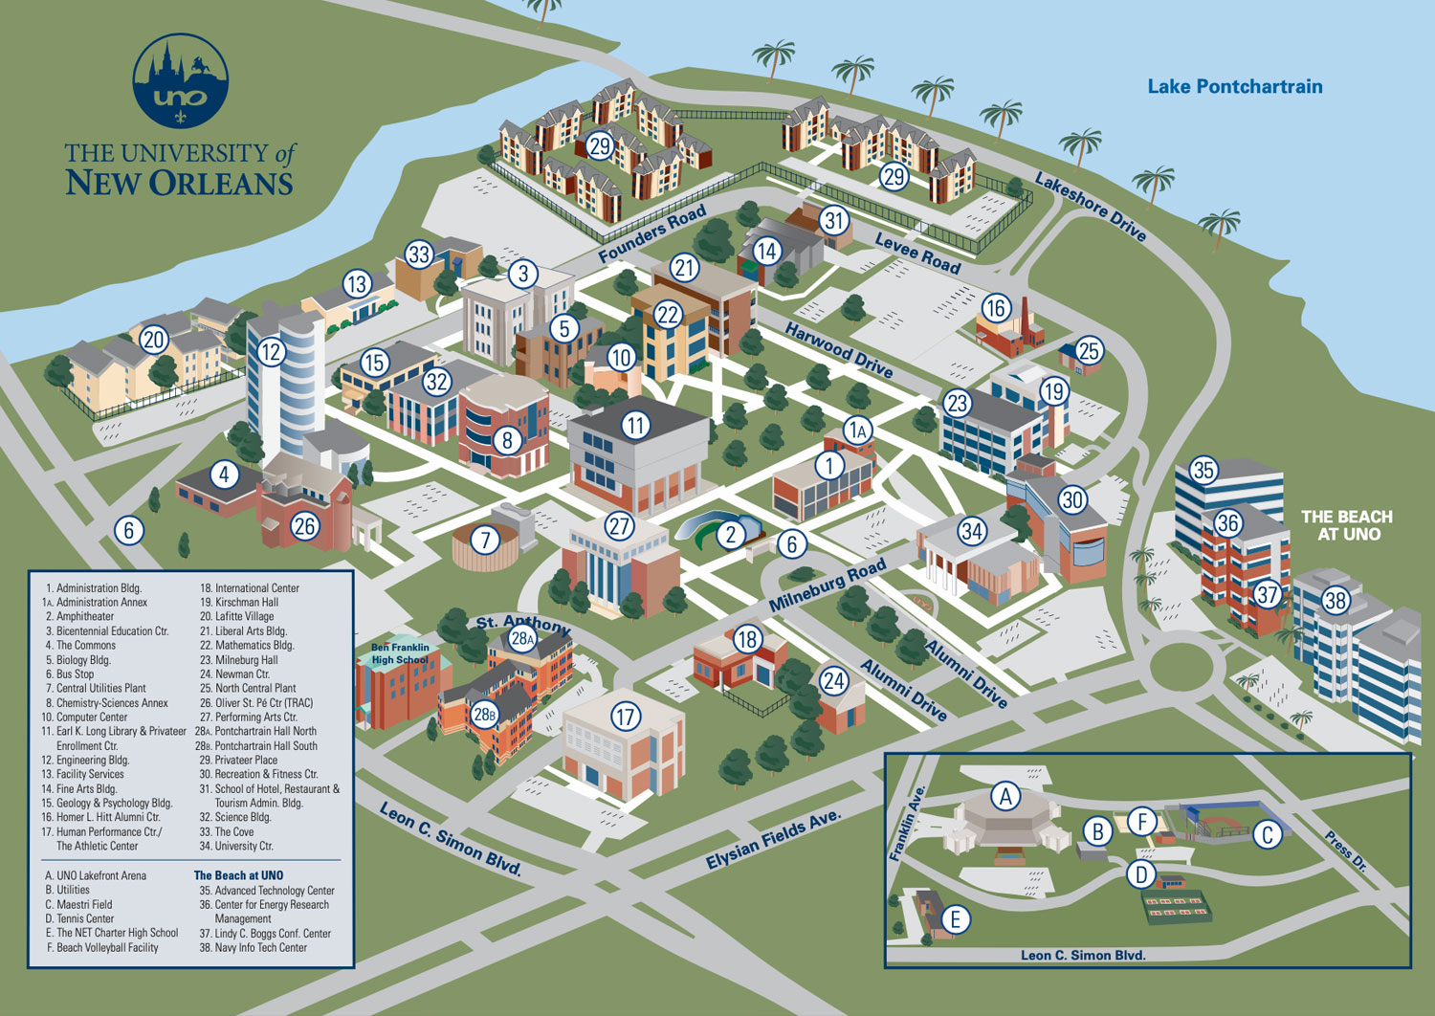
University of New Orleans Planning Priorities
Operations and Infrastructure
Incorporating AI into university operations AND student learning
Strategic investment in P3s to reduce expenses/enhance outcomes
Reduce energy consumption/engage in sustainable practices
Strive to become an employer-of- choice for staff and faculty
Design a welcoming and beautiful campus environment

Slide 11
Major Caveat: This is my aspirational vision (as of January 9) – not OUR vision
Visioning Survey and Analysis
Strategic Planning
Endorsement by UL System and Transition to Implementation Planning
November – December 2023
January – May 2024
June 2024 and Beyond
Iterative Annual Adjustments Fuel Continuous Improvement

Slide 12


Your feedback (What’s missing? What should be amplified? What doesn’t make sense?) is most welcome!
Email: Kathy.Johnson@uno.edu
@KJohnsonUNO

